Slide 1
Case Study - Taxi dataset

Slide 2
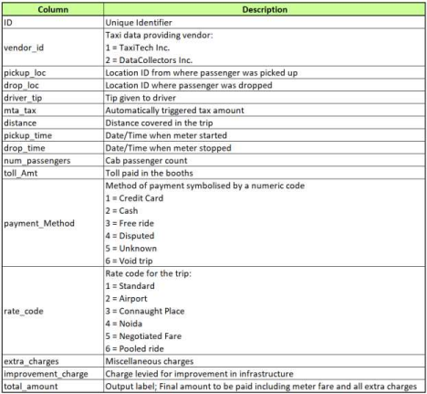
Introduction to dataset
Dataset includes cab details of a city in US. Data dictionary has been given below for reference:

Slide 3
Method used
Data Wrangling
Exploratory Data Analysis
Data Visualizatio

Slide 4
Data Wrangling - Using the pandas
Load the Taxi dataset
Using the standard python library Pandas function understand the dataset
Using shape - identifies the no of rows and column, head / tails by default load top/ last five rows
Using info()-prints full summary about the dataframe with dtype and null value counts and memory storage
Describe -function produces descriptive statistics for the dataframe, that is, the central tenancy (mean, median, min, max, etc.), dispersion, etc.
After understanding the features of dataset.From pickup time and drop time extracted the hour , ptime in minutes and dtime in minutes
Calculated the trip duration by subtracting dtime- ptime .
With given distance value and derived trip duration value .created new column as speed covered and calculated distance /time for each trip

Slide 5
EDA
Step 1.- Data Cleaning
Data cleaning- . Analyise 10 % of the data have null/ empty value . furtherly it is suggested to remove/ delete data so much .
To treat missing value . I have dropped those rows using dropna()
After removing null values still dataset erroneous found the invalid data “#NAME?” stored as value in multiple column
To treat such the data error / noises=I have replaced the “#NAME?” with 0 in multiple to improve the data correctness
In ratecode feature we have found 99 as invalid data value furtherly it is being replaced with mostly occurred rate code
Step2 - Outliers
After processing the data with complete cleaning we checked with outliers of dataset
In num_passengers after plotting boxplot we found outliers as passenger count = 0
In distance traveled and trip time has values less than 1
To treat such outliers we drop such data when num_passenger = 0 and distance and trip _duration < 1

Slide 6
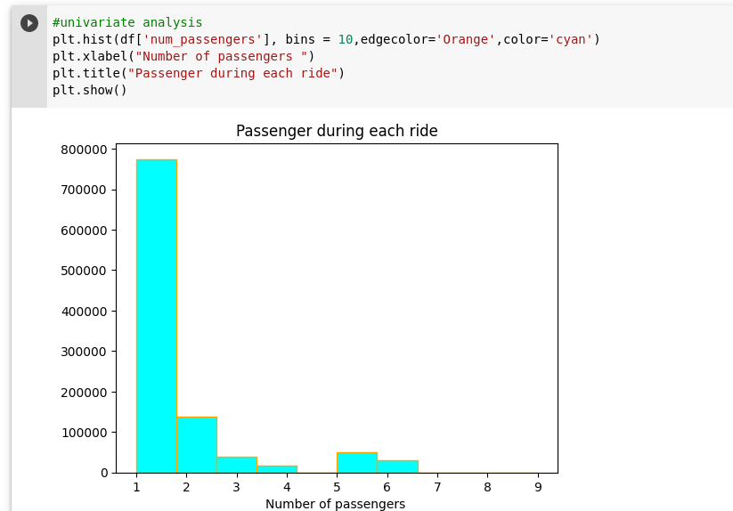
Univariate Analysis

Slide 7
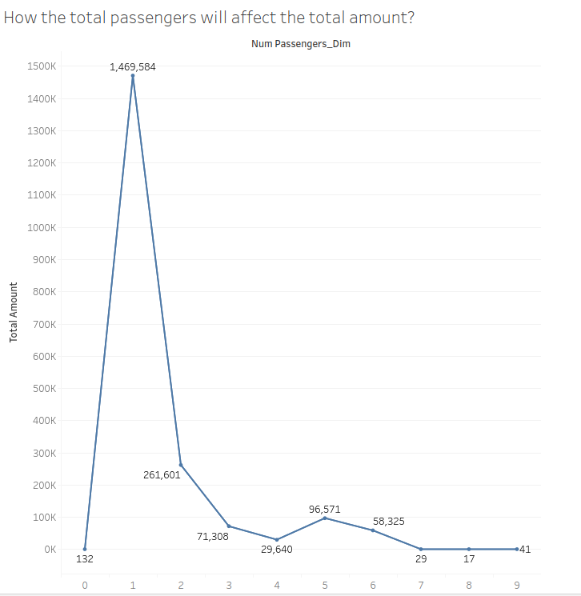
Bi-variate analysis

Slide 8
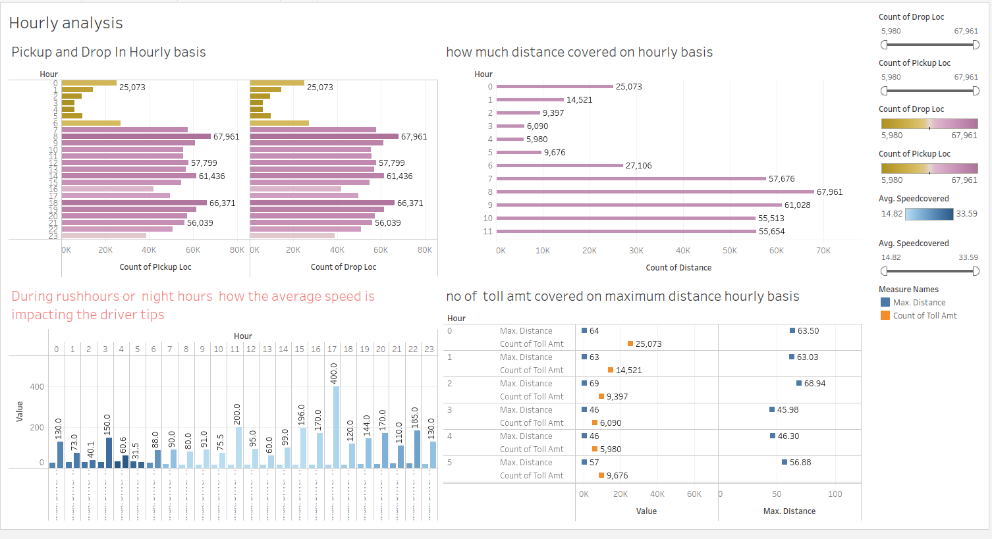
Data Visualization

Slide 9
Points for Dashboard 1
From morning 7am to 3pm 53k- 68k customers have picked and dropped on various locations per hour . Drivers have maximum pickup and drop during this slot
There is Sharp Rise in Pickup and Drop in from 6am to 7am
Pickup and Drop Steadily decrease from 7pm to Evening
In top right sheet there is sharp rise in distance covered after 5 am
As morning hour 8 am and evening hour 6 pm covered maximum distance as 67000 km
After 6pm the nof of km travelled keep decreasing steadily
In bottom left at 5 pm the driver got maximum tip of 400$ the avg speed maintain is 14.6
After 5pm there is sharp decrease in tip received During rush hour 6 pm to 10 pm almost 50% less tip is received by driver
In Bottom right visualization there is no impact of toll amount paid when distance is maximum 68k and minimum 29k km

Slide 10
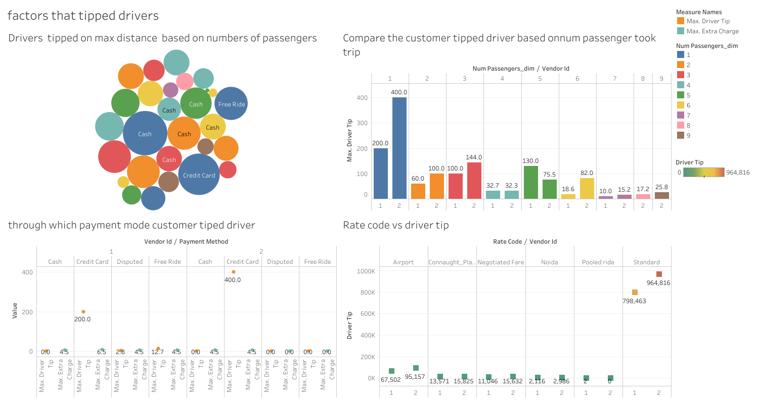
Dashboard 2

Slide 11
Points for Dashboard2
In top left visualization driver got tipped for 400$ when number of passenger 1 and passenger is making payment through credit card
Customers are tipping driver even for free ride minimum of 12$ and when no of passenger are 4
When the no of passengers are more in ride there is no increase in tipping driver
Drivers are getting tipped when irrespective no of passenger if they make payment through credit card
In top right visualization Both vendors received highest tip when no of passenger is only 1
For vendors 1 driver received 50 % less tip as compared to vendors 2 driver
When num_passenger are more than 7 only vendor 2 driver get minimum tip of 30 $
Both vendor drivers get equal tipped for ride when they carry 4 passengers
As the no of passenger are 5 member vendor1 got tipped doubled of vendor2 drivers
In bottom Right visualization In standard rate code vendor 2 received total tip of 200k extra from vendor 1
In pooled rider vendor 1 drivers get tip maximum 2$ while vendors 2 driver didnt get any tip for ride
From airport total tip received for vendor 2 drivers is only 98K which 30 k more than vendor1 drivers apart from standard rate code driver get tip when they take ride from /to airport

Slide 12
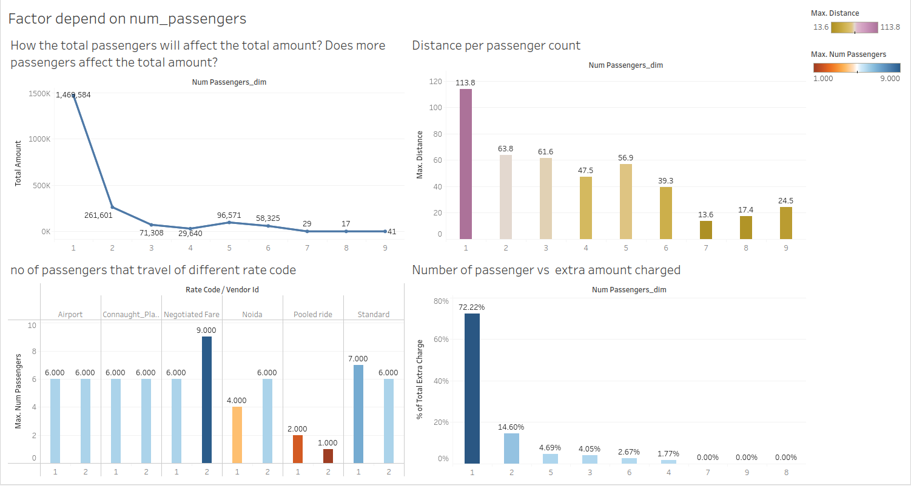
Dashboard-3

Slide 13
Points for dashboard 3
In top left visualization when num_pasenger are alone the total revenue generated is 1500k.
There is sharp drop in revenue generation passenger are increased to 2 as difference of 1200K$ in revenue
When no of passengers is 7 or more the total revenue generated is approximately 41 $ at max
In top right visualization maximum distance covered approx 114 km for lonely passenger
When count of passenger increase from 1 from the distance traveled in Km is 50% less
when num_passenger is 7 or more distance travelling is slightly increasing (short trips)
In bottom left visualization both vendors drivers can carry maximum 6 passenger for ride irrespective when pickup/drop is at airport and connaught place
When maximum passenger took ride customer negtoitate with the existing fare
Pooled ride usually carry no of passenger not more than 2
In bottom right visualization when no of passenger are 7 or more they did not need to pay extra amount
When lone passenger is travelling the extra amount is charged is 72 % which is highest of all.
More than one passenger travelling got charged extra amount 50 -55% less

Slide 14
Business Recommendation
Free ride need to provided for passenger who took short trip with minimum count passenger
Pooled or share cab should be designed for short trips
Disputed fare and negotiated fare should not include the extra charge
Pool ride should be given where the pickups and drops are maximum
Except 0-6 hours cab service should be provided with min extra charge on ride

Slide 15
Future Research and Analysis Opportunities
When the passenger are alone the revenue generated is 50 % more when there are multiple passenger for ride
Only few customers prefer to choose pool / share ride
From 0-6 hours the distance covered is minimum very few passenger look out for taxi services
For Vendors 2 taxi When no of passenger are maximum they prefer ride where they can negotiate fare
Passenger who does payment of ride with cash does not tip driver irrespective of count passenger

